Slide 1
Hosting Zoom session

Slide 2
If you sent the invite you will be the host
when you rejoin at the bottom of the screen it will say If you are the host log on
You have to start the meeting to allow others in
Once logged in you connect and start the meeting waiting for others to join
You have to admit them as they enter from the waiting room
Due to new security a password and waiting room is not automatic for each meeting
As people join you will get a prompt and need to click ADMIT to allow them in your meeting.
If you lock once you start no one else can be admitted, if you do not lock people joining at anytime will cause the ADMIT to display , your choice to allow them or not. At the end of your meeting if you want a small discussion you can move people to the waiting room by right clickin on their name under manage participants.
You have to allow others to share their screen, if you are the host and start the meeting, next to the Screen share click the ^ symbol and choose to let others/multiple people to share otherwise you are the only person that can share. In most cases with you and a student there is no reason to give control to a student.
You have access to control muting and video if there is too much noise
By clicking on manage participants you can see all the participants and can mute if there is back ground noise
The microphone will show color when it is being used by clicking on it you mute and unmute the participant.
You can also mute all – if you are not the speaker when you do this you will mute the speaker as well be prepared to unmute them asap
Same you can stop or ask someone to start their video by clicking the camera

Slide 3
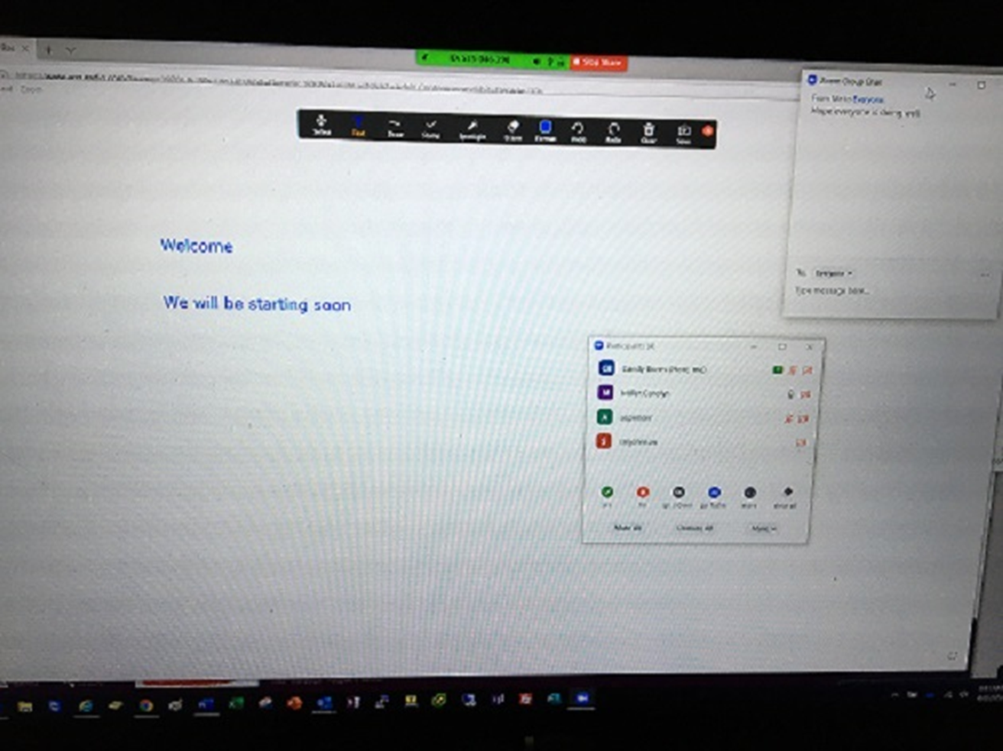
This is an example of a shared screen with the whiteboard displayed that has a text welcome message.
Participants that have joined are shown and are muted
Shared screen is displayed on my user – that indicates that many are allowed and it will show who is sharing
Also was sharing background music while waiting for people to join
With a Chat box open if
Anyone had a question

